Slide 1
Add the title here by going to View > Slide Master and typing the title in the first slide.

Slide 2
Title Here
Bullet one
Bullet two
Bullet three

Slide 3
This is a section header.
Use it to create transitions in your presentation as you segue from one topic to another.

Slide 4

Title Here
Bullet one
Bullet two
Etc.
Image here

Slide 5
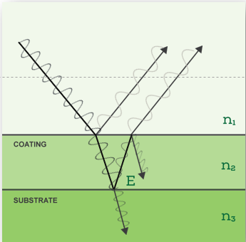
Title Here
Use this for a chart or other visual when you need a caption.
Caption goes here.

Slide 6
Use this slide when you want to make a comparison (animated)
Comparison Item One
Comparison Item Two
Bullet one
Bullet two
Bullet three
Bullet four
Bullet five
Bullet six
Bullet seven
Bullet one
Bullet two
Bullet three
Bullet four
Bullet five
Bullet six
Bullet seven

Slide 7
Use this slide when you want to make a comparison (non-animated)

Slide 8
Next Steps
Define coating measurement application
Submit sample to Sensory Analytics
Sample testing conducted in Sensory Analytics lag
Sample report well be sent for review
Present outline of steps to integration
Delivery of a comprehensive system proposal

Slide 9
Name Here
Title Here
Tel: 1-336-XXX-XXXX
Fax: 1-336-XXX-XXXX
SENSORY ANALYTICS
The Sensory Building
405 Pomona Drive
Greensboro, NC 27407 USA
www.specmetrix.com

