Slide 1
Affordable Property Taxes for All Hoosiers
Neva Butkus
Policy Analyst
Institute on Taxation and Economic Policy
Neva@itep.org

Slide 2
Property tax concerns
Property tax affordability is an issue for many families, as property taxes are often disconnected from a family’s ability to pay.
A gentrifying neighborhood may rapidly increase a family home’s assessed value.
The property tax bill of a family experiencing job loss due to layoffs, a recession, etc. does not change despite their reduced income.

Slide 5
Policies to address property tax concerns
Homestead exemptions:
Flat amount of home-value exempted per homestead
Percent of home-value exempted
Assessment caps:
Limits the growth of property taxes despite increases in assessed value.
Circuit breakers:
Prevent property taxes from exceeding a percentage of household income through refunds or credits.

Slide 7
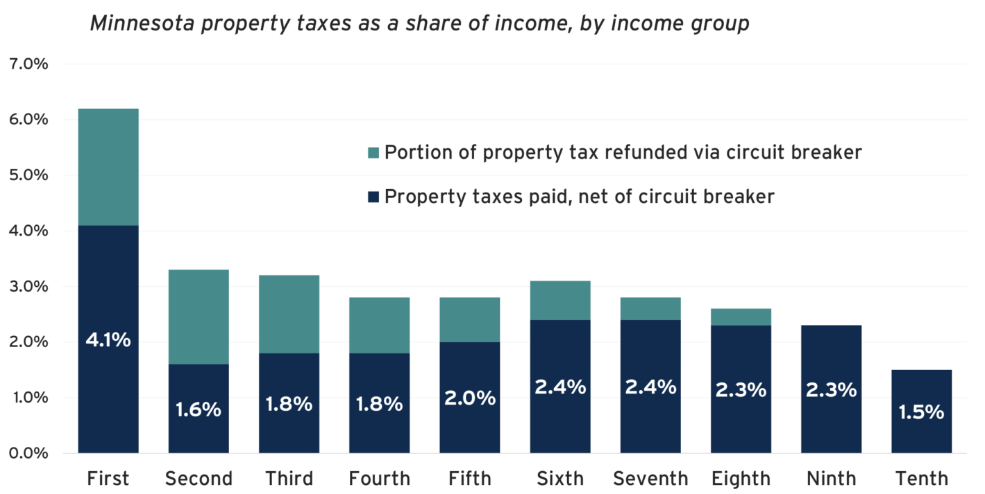
Circuit Breakers Improve Property Tax Fairness

