Slide 1
An in-depth look at
state taxes across America

Slide 2
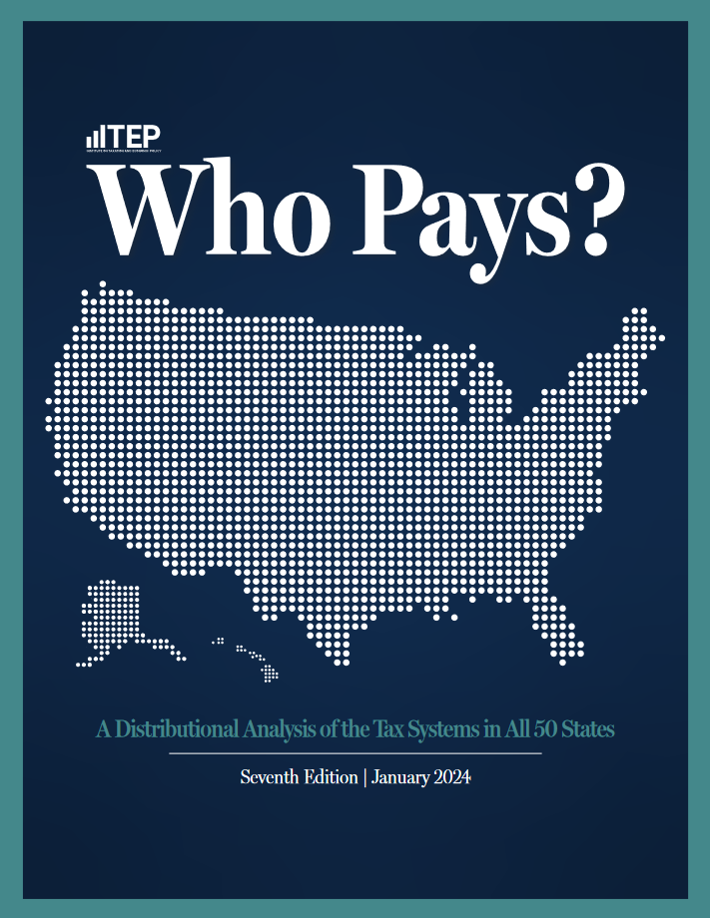
Study Overview:
7th edition of the study. First edition published in 1996.
The only comprehensive, 50-state study of state and local tax incidence.
Similar method, and findings, to single-state studies by agencies in Minnesota, Texas, etc.
99.7% coverage of state and local taxes (varies from 98-100% across states, including 99.7% in VT.)

Slide 3
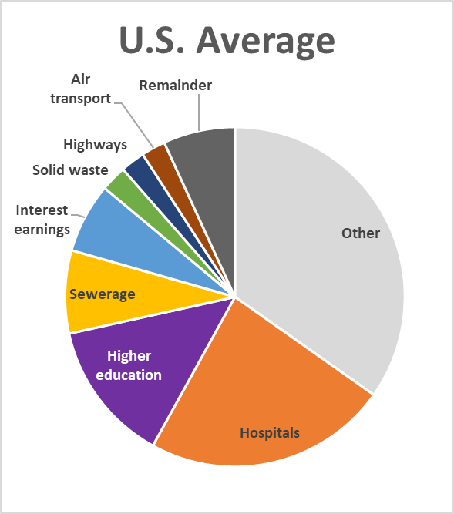
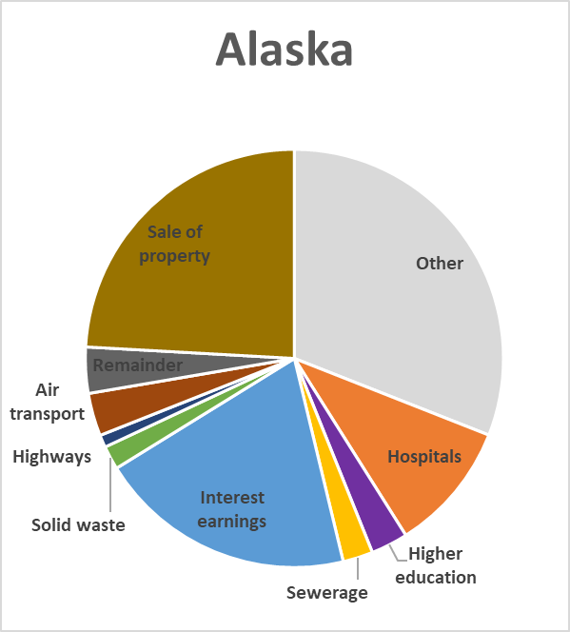
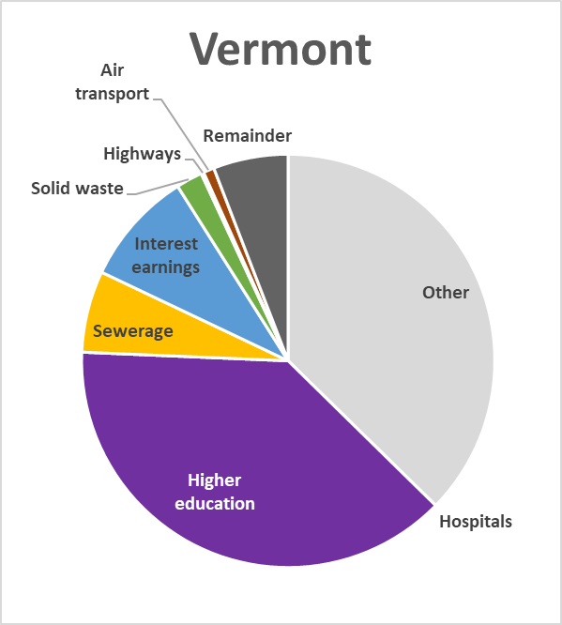
Non-Tax Revenue Sources
State and Local Combined
Source: ITEP compilation of data from the U.S. Census Bureau, 2021 Annual Surveys of State and Local Government Finances

Slide 4
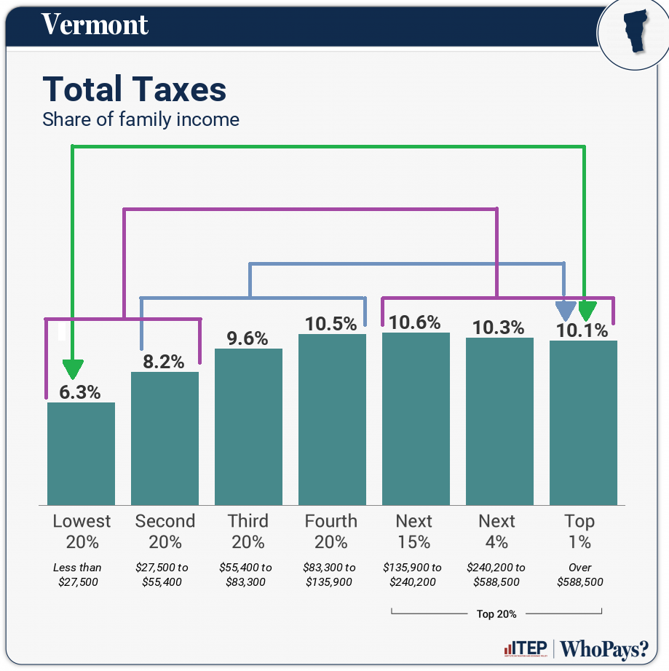
Components of Index Calculation

Slide 5
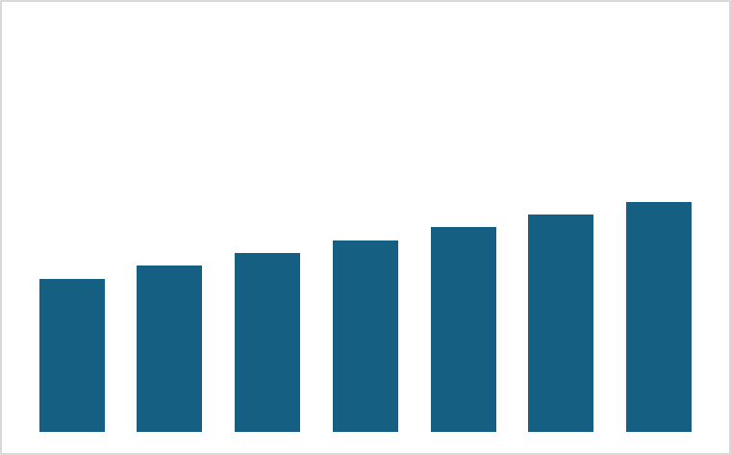
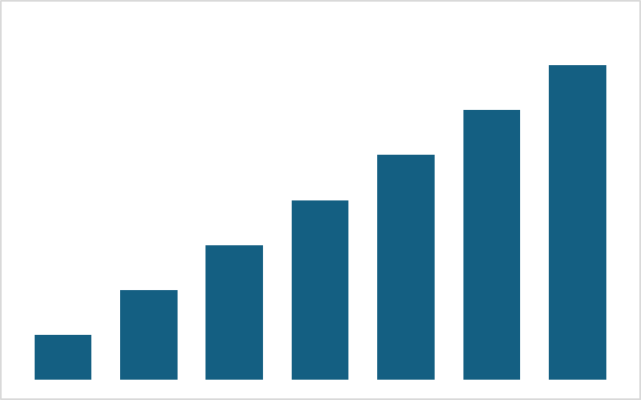
Example Tax Distributions
Somewhat Progressive More Progressive

Slide 6
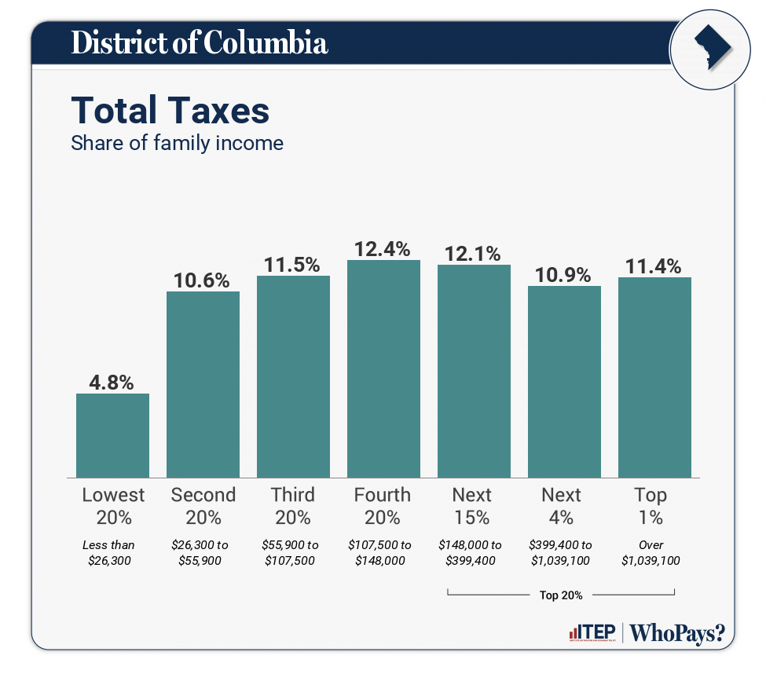
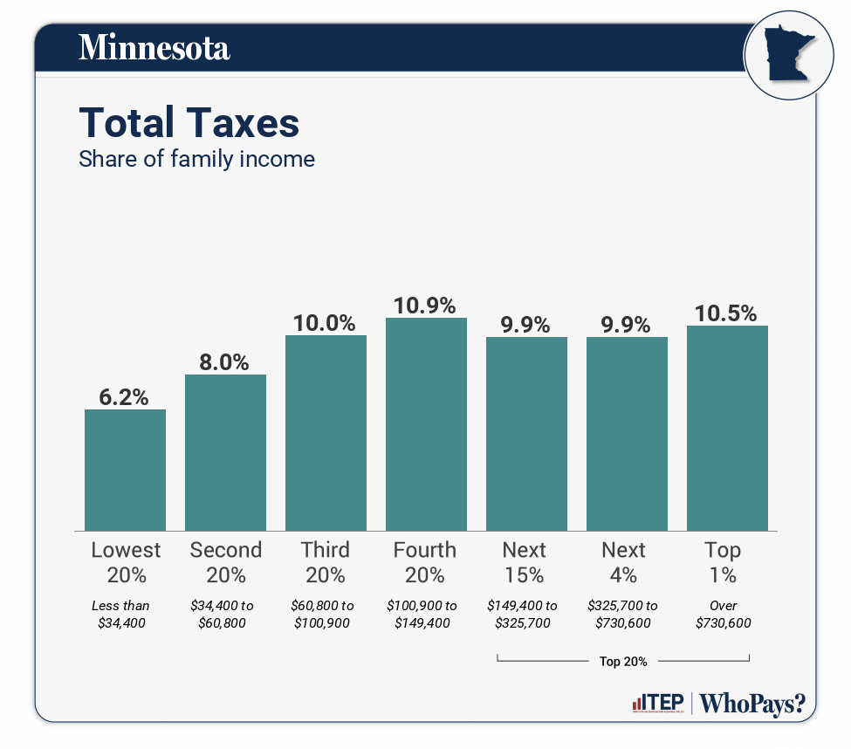
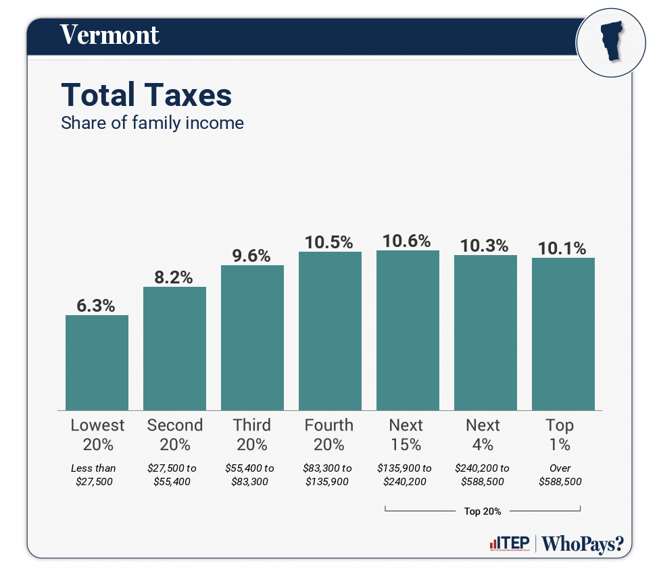
Index Rankings
#1 #2 #3

Slide 7
Recent Reforms Have Affected State Rankings
Gains in State Rankings, from Appendix D
Minnesota: +3 spots.
Most progressive state. (2nd most progressive jurisdiction after D.C.).
Capital gains tax; corporate tax; itemized deduction reform; low-income credits.
Massachusetts: +10 spots.
Now among the top 10 least regressive states.
Millionaires’ tax; low-income credits.
New Mexico: +18 spots.
Largest jump of any state. Now among the 10 least regressive states.
New top bracket; capital gains reform; low-income credits.
Washington: +1 spot.
No longer the nation’s most regressive tax code.
Capital gains tax; low-income credits.

Slide 8
Read More:
www.whopays.org
www.itep.org

