Slide 1
Property Tax Circuit Breakers
Brakeyshia Samms
Policy Analyst
Institute on Taxation and Economic Policy
Brakeyshia@itep.org

Slide 2
Circuit Breakers Stand Apart
Circuit breakers are the only type of property tax cut explicitly designed to reduce the property tax load on those most affected by the tax.
Unlike tax caps or homestead exemptions, circuit breakers undertake a direct measurement of each family’s ability to pay property tax—as measured by their income—and calibrate the credit or rebate to ensure that their final net tax bill is affordable.
Notes:
Prop tax is not connected to ability to pay

Slide 3
Types of Circuit Breakers
The most common form of help is a threshold-style circuit breaker.
Under this approach, credits or rebates are calculated using a formula that compares property tax liability to income and offsets some or all the property tax that exceeds what is designated as unaffordable under the program.

Slide 4
Notes:
Currently, 29 states and the District of Columbia offer property tax circuit breaker programs.
Another 16 states do not offer circuit breakers but have at least one other type of income-limited property tax break.
Just five states do not offer any kind of income-based property tax break: Arkansas, Kentucky, Mississippi, South Carolina, and Texas.

Slide 5
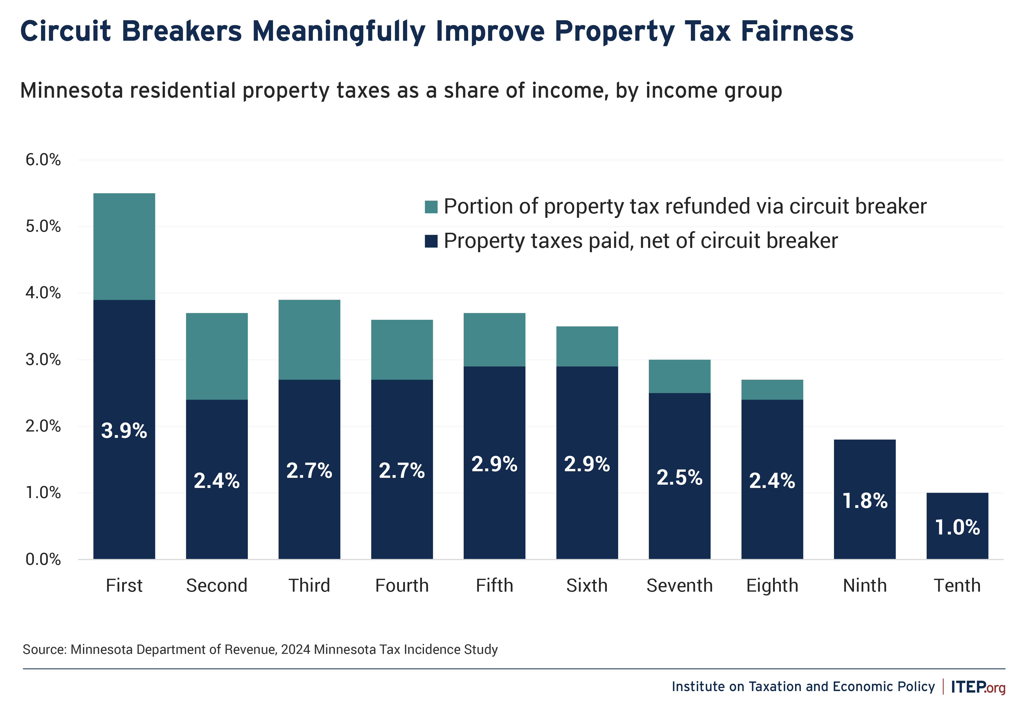

Slide 6
Property Tax Circuit Breaker Materials
Research Report: https://itep.org/property-tax-affordability-circuit-breaker-credits/
Contact info: Brakeyshia@itep.org

